Slide 1

Supervised Classification Algorithms for Early Detection of Diabetes
The University of Oklahoma
Course: Intelligent Data Analytics (DSA-5103-OL)
Fall 2024 Semester
Group 3 Presentation
Instructor
Professor Charles Nicholson
Group 3 members
Alex Hunt
Oluchi Ejehu
Zainab Iyiola

Slide 2
INTRODUCTION
What?
Diabetes is a chronic condition with significant health, social and economic consequences
Early detection is critical for effective management and prevention of complications
Why ML?
Machine learning is an invaluable tool in healthcare, enabling predictive models for classifying diabetic and non-diabetic patients
How?
This project uses supervised classification algorithms to build an effective model for early diabetes detection.

Slide 3



OBJECTIVES
This Project seeks to:
Determine how supervised classification algorithms can effectively predict diabetes using available patient health metrics.
Investigate which Machine learning algorithms provide the most robust and accurate predictions and how the performance can be interpreted in a clinical context.
Determine the necessary preprocessing steps to address data quality issues such as outliers and skewed distribution that could hinder model performance.

Slide 4
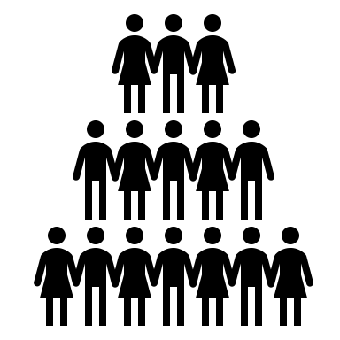




PROJECT WORKFLOW
DATA COLLECTION
Data consists of 9 features
DATA CLEANING AND PREPROCESSING
Handling missing data
FEATURE ENGINEERING
Synthetic data generation
MODEL DEVELOPMENT
MODEL OPTIMIZATION & EVALUATION
768 records
Outlier detection
Feature distribution analysis
Feature scaling
Normalization
Correlation analysis
Logistic regression
Random Forest
Support Vector Machine
XGBoost
Performance metrics
Accuracy
F1-Score
Confusion matrix
Exploratory Data Analysis

Slide 5
DATA DESCRIPTION
Features | Description
Pregnancies | Number of Times a patient has been pregnant.
Glucose | Plasma glucose concentration in an oral glucose tolerance test.
Blood Pressure | Diastolic blood pressure (mm Hg).
Skin Thickness | Triceps skinfold thickness (mm)
Insulin | Serum Insulin Concentration (mu U/ml).
BMI | Body Mass Index, calculated as weight (kg)/ height (m)2.
Diabetes Pedigree Function | Scores the likelihood of diabetes based on family history.
Age | Patient age (in years).
Outcome | Binary variable indicating diabetes diagnosis (1 = diabetic, 0 = non-diabetic).

Slide 6
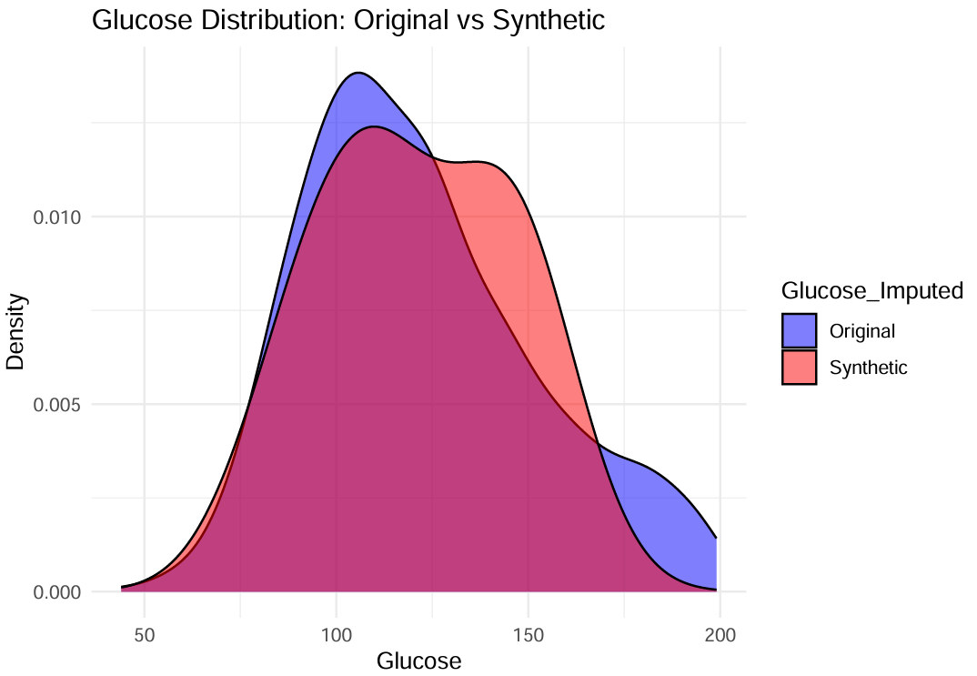
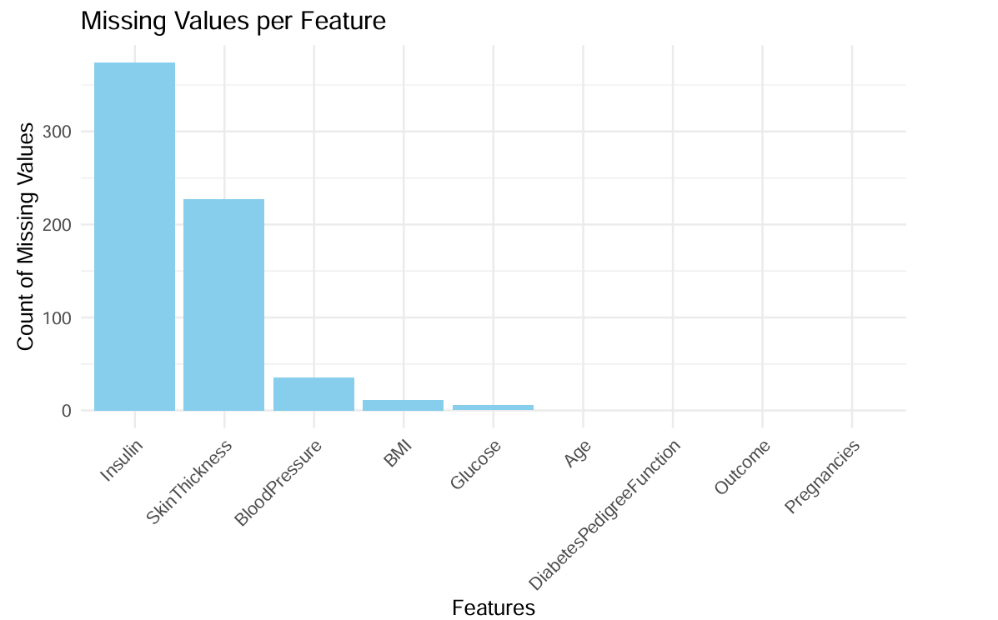
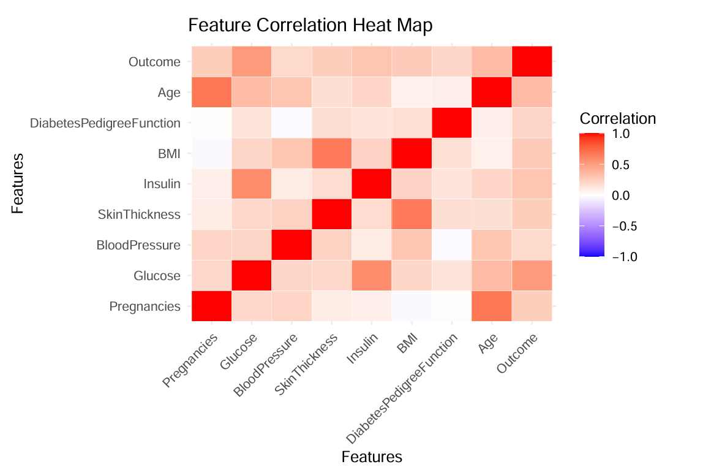
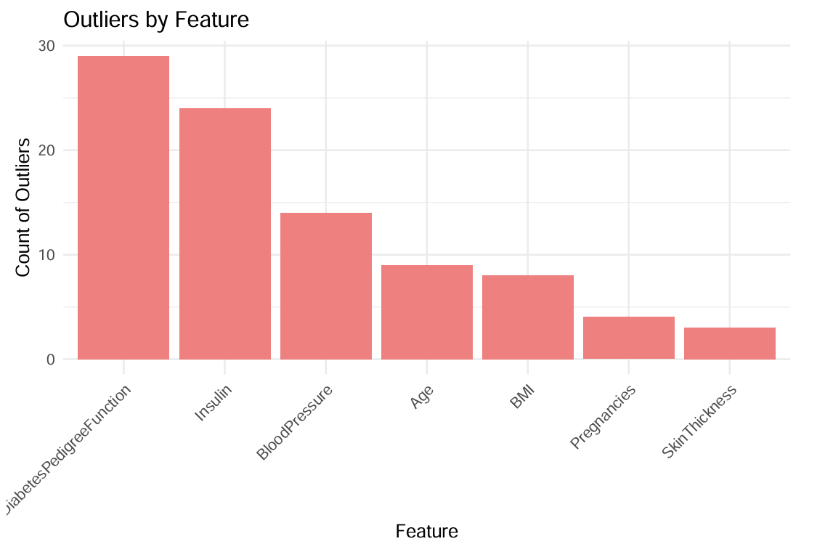
DATA CLEANING AND PREPROCESSING
Missing Values Detection & Treatment
Feature Distribution
Outlier Detection
Correlation Analysis

Slide 7
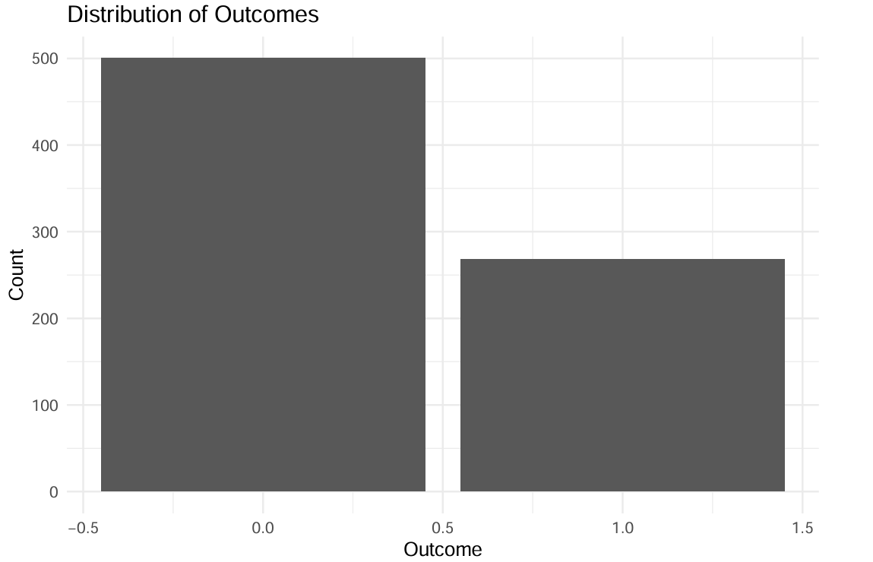
FEATURE ENGINEERING
The dataset has a disproportionately higher number of non-diabetic cases (Outcome = 0) compared to diabetic cases (Outcome = 1).
This imbalance can bias the machine learning models toward the majority class, resulting in higher false negatives for diabetic cases.
Thus informed the decision to generate synthetic datasets to improve the models’ sensitivity in detecting diabetic cases.

Slide 8
MODEL DEVELOPMENT
Logistic Regression
Random Forest
Selected for its ability to capture complex, non-linear relationships and feature importance analysis.
Support Vector Machine (SVM)
Utilized for its robust classification capabilities in high-dimensional data.
Gradient Boosting (XGBoost)
Baseline model for its simplicity and interpretability.
Chosen for handling imbalanced datasets effectively and improving prediction accuracy through iterative learning.
Dataset split into 70% training and 30% testing sets.
Both the original dataset and a synthetic dataset (to address class imbalance) were used for model evaluation.

Slide 9
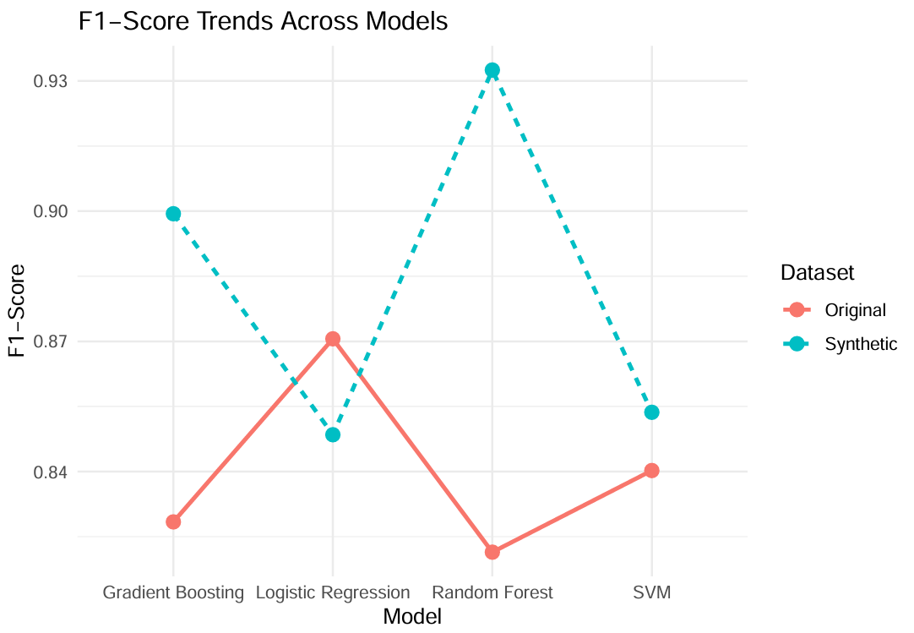
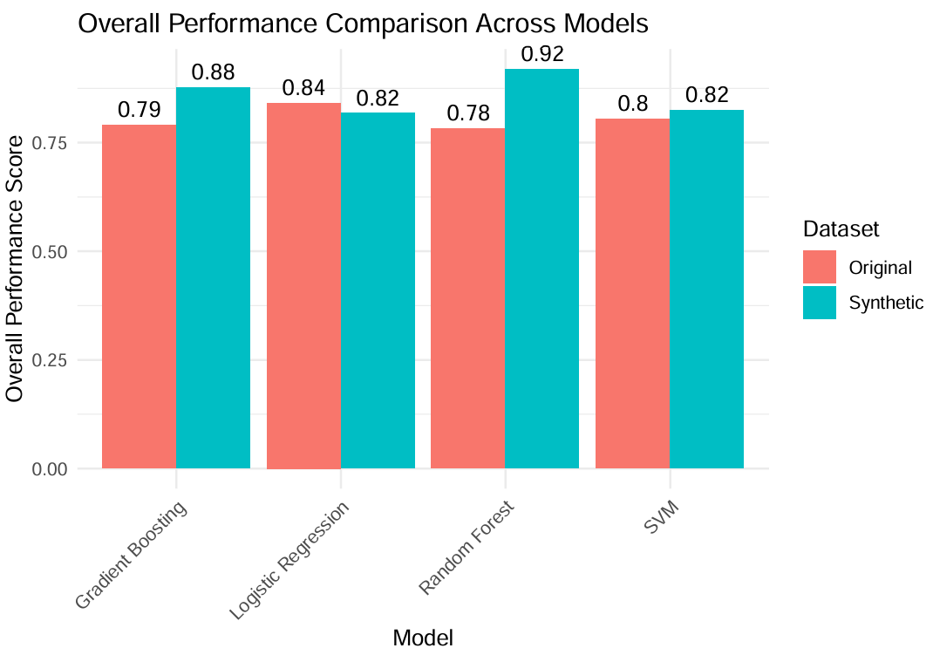

RESULT AND DISCUSSION
Models trained on synthetic datasets consistently outperformed those trained on original datasets.
Random Forest benefited the most from synthetic data, showing a significant boost in accuracy and F1-score, while SVM showed moderate improvements, and Gradient Boosting remained consistent across datasets.

Slide 10




CONCLUSIONS
Successfully applied supervised classification algorithms for early diabetes detection. Robust preprocessing, feature engineering and synthetic data generation addressed challenges like class imbalance and missing data.
Random Forest was the most effective model, achieving superior performance with synthetic data. Glucose and BMI were identified as the most significant predictors of diabetes.
Synthetic data assumes accurate representation of real-world scenarios
Further testing is needed to validate model scalability and generalizability in clinical environments
This project highlights the potential of machine learning in addressing healthcare challenges with enhanced sensitivity and reduced false negatives.
Notes:
Summary of Work:
Successfully applied supervised classification algorithms for early diabetes detection.
Robust preprocessing, feature engineering, and synthetic data generation addressed challenges like class imbalance and missing data.
Key Insights:
Random Forest was the most effective model, achieving superior performance with synthetic data.
Glucose and BMI were identified as the most significant predictors of diabetes.
Critical Assumptions and Limitations:
Synthetic data assumes accurate representation of real-world scenarios.
Further testing is needed to validate model scalability and generalizability in clinical environments.
Potential Impact:
Provides a foundation for developing reliable diagnostic tools to improve early detection and management of diabetes.
Highlights the potential of machine learning in addressing healthcare challenges with enhanced sensitivity and reduced false negatives.

